Slide 1
14
Cost of Capital
Prepared by Anne Inglis, Ryerson University
Notes:
12.<number>

Slide 2
Financial management for engineers: Summer 2019
Week 6:
Cost of capital
14-<number>

Slide 3
Why Cost of Capital Is Important 14.1
All
LOs
We know that the return earned on assets depends on the risk of those assets
The return to an investor is the same as the cost to the company
Our cost of capital provides us with an indication of how the market views the risk of our assets
Knowing our cost of capital can also help us determine our required return for capital budgeting projects
14-<number>
Notes:
12.<number>

Slide 4
Required Return
All
LOs
The required return is the same as the appropriate discount rate and is based on the risk of the cash flows
We need to know the required return for an investment before we can compute the NPV and make a decision about whether or not to take the investment
We need to earn at least the required return to compensate our investors for the financing they have provided
14-<number>
Notes:
12.<number>

Slide 5
Cost of Equity 14.2
LO1
The cost of equity is the return required by equity investors given the risk of the cash flows from the firm
There are two major methods for determining the cost of equity
  Dividend growth model
  SML or CAPM
14-<number>
Notes:
12.<number>

Slide 6
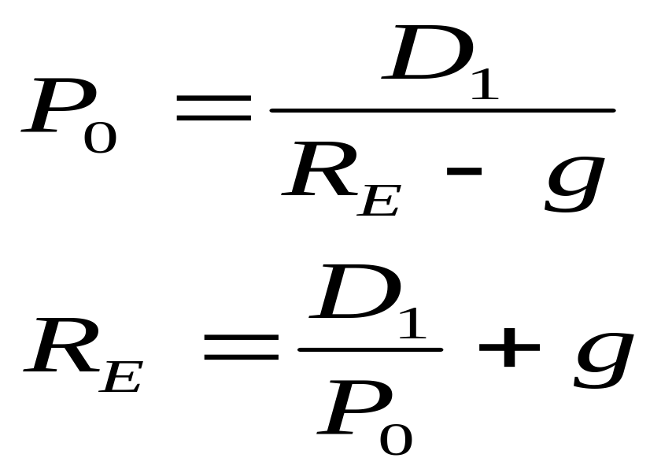
The Dividend Growth Model Approach
LO1
Start with the dividend growth model formula and rearrange to solve for R_{E}
14-<number>
Notes:
12.<number>
Remind students that D₁ = D₀(1+g)
You may also want to take this time to remind them that return is comprised of the dividend yield (D₁ / P₀) and the capital gains yield (g)

Slide 7
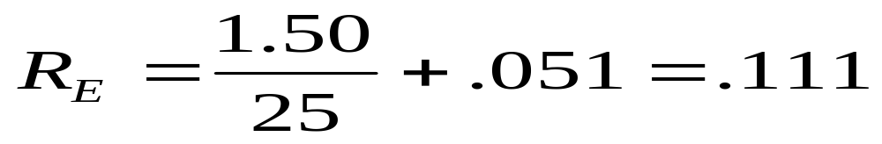
Dividend Growth Model – Example 1
LO1
Suppose that your company is expected to pay a dividend of $1.50 per share next year. There has been a steady growth in dividends of 5.1% per year and the market expects that to continue. The current price is $25. What is the cost of equity?
14-<number>
Notes:
12.<number>
So, investors are currently requiring a return of 11.1% on our equity capital.

Slide 8
Example: Estimating the Dividend Growth Rate
LO1
One method for estimating the growth rate is to use the historical average
  Year Dividend Percent Change
  1995 1.23
  1996 1.30
  1997 1.36
  1998 1.43
  1999 1.50
(1.30 – 1.23) / 1.23 = 5.7%
(1.36 – 1.30) / 1.30 = 4.6%
(1.43 – 1.36) / 1.36 = 5.1%
(1.50 – 1.43) / 1.43 = 4.9%
Average = (5.7 + 4.6 + 5.1 + 4.9) / 4 = 5.1%
14-<number>
Notes:
12.<number>
Our historical growth rates are reasonably close, so we could feel reasonably comfortable that the market will expect our dividend to grow at around 5.1%. Note that when we are computing our cost of equity, it is important to consider what the market expects our growth rate to be, not what we may know it to be internally. The market price is based on market expectations, not our private information.
Another way to estimate the market consensus estimate is to look at analysts’ forecasts and take an average.

Slide 9
Alternative Approach to Estimating Growth
LO1
If the company has a stable ROE, a stable dividend policy and is not planning on raising new external capital, then the following relationship can be used:
  g = Retention ratio x ROE
XYZ Co is has a ROE of 15% and their payout ratio is 35%. If management is not planning on raising additional external capital, what is XYZ’s growth rate?
  g = (1-0.35) x 0.15 = 9.75%
14-<number>
Notes:
12.<number>

Slide 10
Advantages and Disadvantages of Dividend
Growth Model
LO1
Advantage – easy to understand and use
Disadvantages
  Only applicable to companies currently paying dividends
  Not applicable if dividends aren’t growing at a reasonably constant rate
  Extremely sensitive to the estimated growth rate – an increase in g of 1% increases the cost of equity by 1%
  Does not explicitly consider risk
14-<number>
Notes:
12.<number>
Point out that there is very little allowance for uncertainty about the growth rate. Small errors in the growth rate will magnify into large errors in the overall analysis.

Slide 11
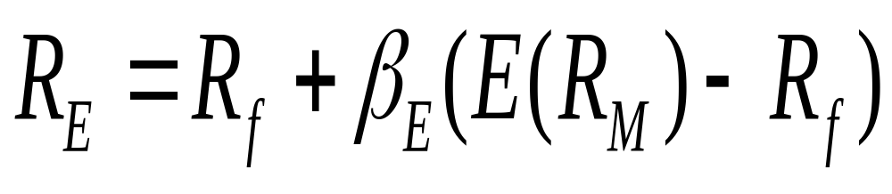
The SML Approach
LO1
Use the following information to compute our cost of equity
  Risk-free rate, R_{f}
  Market risk premium, E(R_{M}) – R_{f}
  Systematic risk of asset, β
14-<number>
Notes:
12.<number>
You will often hear this referred to as the Capital Asset Pricing Model Approach as well.

Slide 12
Example 1 revisited – SML
LO1
Suppose your company has an equity beta of .58 and the current risk-free rate is 6.1%. If the expected market risk premium is 8.6%, what is your cost of equity capital?
  R_{E} = 6.1 + .58(8.6) = 11.1%
Since we came up with similar numbers using both the dividend growth model and the SML approach, we should feel pretty good about our estimate
14-<number>
Notes:
12.<number>

Slide 13
Advantages and Disadvantages of SML
LO1
Advantages
  Explicitly adjusts for systematic risk
  Applicable to all companies, as long as we can compute beta
Disadvantages
  Have to estimate the expected market risk premium, which does vary over time
  Have to estimate beta, which also varies over time
  We are relying on the past to predict the future, which is not always reliable
14-<number>
Notes:
12.<number>

Slide 14
Example – Cost of Equity
LO1
Suppose our company has a beta of 1.5. The market risk premium is expected to be 9% and the current risk-free rate is 6%. We have used analysts’ estimates to determine that the market believes our dividends will grow at 6% per year and our last dividend was $2. Our stock is currently selling for $15.65. What is our cost of equity?
  Using SML: R_{E} = 6% + 1.5(9%) = 19.5%
  Using DGM: R_{E} = [2(1.06) / 15.65] + .06 = 19.55%
14-<number>
Notes:
12.<number>
Since the two models are reasonable close, we can assume that our cost of equity is probably around 19.5%

Slide 15
Cost of Debt 14.3
LO2
The cost of debt is the required return on our company’s debt
We usually focus on the cost of long-term debt or bonds
The required return is best estimated by computing the yield-to-maturity on the existing debt
We may also use estimates of current rates based on the bond rating we expect when we issue new debt
The cost of debt is NOT the coupon rate
14-<number>
Notes:
12.<number>
Point out that the coupon rate was the cost of debt for the company when the bond was issued. We are interested in the rate we would have to pay on newly issued debt, which could be very different from past rates.

Slide 16
Example: Cost of Debt
LO2
Suppose we have a bond issue currently outstanding that has 25 years left to maturity. The coupon rate is 9% and coupons are paid semiannually. The bond is currently selling for $908.72 per $1000 bond. What is the cost of debt?
  N = 50; PMT = 45; FV = 1000; PV = -908.75; CPT I/Y = 5%; YTM = 5(2) = 10%
14-<number>
Notes:
12.<number>
Remind students that it is a trial and error process to find the YTM if they do not have a financial calculator or spreadsheet.

Slide 17
Cost of Preferred Stock
LO1
Reminders
  Preferred generally pays a constant dividend every period
  Dividends are expected to be paid every period forever
Preferred stock is an annuity, so we take the annuity formula, rearrange and solve for R_{P}
R_{P} = D / P₀
14-<number>
Notes:
12.<number>

Slide 18
Example: Cost of Preferred Stock
LO1
Your company has preferred stock that has an annual dividend of $3. If the current price is $25, what is the cost of preferred stock?
R_{P} = 3 / 25 = 12%
14-<number>
Notes:
12.<number>

Slide 19
The Weighted Average Cost of Capital 14.4
LO3
We can use the individual costs of capital that we have computed to get our “average” cost of capital for the firm.
This “average” is the required return on our assets, based on the market’s perception of the risk of those assets
The weights are determined by how much of each type of financing that we use
14-<number>
Notes:
12.<number>

Slide 20
Capital Structure Weights
LO3
Notation
  E = market value of equity = # outstanding shares times price per share
  D = market value of debt = # outstanding bonds times bond price
  V = market value of the firm = D + E
Weights
  w_{E} = E/V = percent financed with equity
  w_{D} = D/V = percent financed with debt
14-<number>
Notes:
12.<number>
Note that for bonds we would find the market value of each bond issue and then add them together.
Also note that preferred stock would just become another component of the equation if the firm has issued it.
Finally, we generally ignore current liabilities in our computations. However, if a company finances a substantial portion of its assets with current liabilities, it should be included in the process.

Slide 21
Example: Capital Structure Weights
LO3
Suppose you have a market value of equity equal to $500 million and a market value of debt = $475 million.
  What are the capital structure weights?
    V = 500 million + 475 million = 975 million
    w_{E} = E/D = 500 / 975 = .5128 = 51.28%
    w_{D} = D/V = 475 / 975 = .4872 = 48.72%
14-<number>
Notes:
12.<number>

Slide 22
Taxes and the WACC
LO3
We are concerned with after-tax cash flows, so we need to consider the effect of taxes on the various costs of capital
Interest expense reduces our tax liability
  This reduction in taxes reduces our cost of debt
  After-tax cost of debt = R_{D}(1-T_{C})
Dividends are not tax deductible, so there is no tax impact on the cost of equity
WACC = w_{E}R_{E} + w_{D}R_{D}(1-T_{C})
14-<number>
Notes:
12.<number>
Point out that if we have other financing that is a significant part of our capital structure, we would just add additional terms to the equation

Slide 23
Example 1 – WACC
LO3
Equity Information
  50 million shares
  $80 per share
  Beta = 1.15
  Market risk premium = 9%
  Risk-free rate = 5%
Debt Information
  $1 billion in outstanding debt (face value)
  Current quote = 110
  Coupon rate = 9%, semiannual coupons
  15 years to maturity
Tax rate = 40%
14-<number>
Notes:
12.<number>
Remind students that bond prices are quoted as a percent of par value

Slide 24
Example 1 – WACC continued
LO3
What is the cost of equity?
  R_{E} = 5 + 1.15(9) = 15.35%
What is the cost of debt?
  N = 30; PV = -1100; PMT = 45; FV = 1000; CPT I/Y = 3.9268
  R_{D} = 3.927(2) = 7.854%
What is the after-tax cost of debt?
  R_{D}(1-T_{C}) = 7.854(1-.4) = 4.712%
14-<number>
Notes:
12.<number>
Point out that students do not have to compute the YTM based on the entire face amount. They can still use a single bond.

Slide 25
Example 1 – WACC continued
LO3
What are the capital structure weights?
  E = 50 million (80) = 4 billion
  D = 1 billion (1.10) = 1.1 billion
  V = 4 + 1.1 = 5.1 billion
  w_{E} = E/V = 4 / 5.1 = .7843
  w_{D} = D/V = 1.1 / 5.1 = .2157
What is the WACC?
  WACC = .7843(15.35%) + .2157(4.712%) = 13.06%
14-<number>
Notes:
12.<number>

